Slide 1
Unveiling the Diabetic
Summary of Work on Diabetes Data Analysis
Data Distribution and Model Performance
NAME : GUDLA SRIYA
DATE : 29-05-2024

Slide 2
Introduction
Overview of a project :
Analyze diabetes dataset to predict disease progression.
Outline the main objectives: understanding data distribution, building predictive models, evaluating model performance.
Data Description
Dataset Overview:
Source: Diabetes Dataset file with an extension of ‘CSV’- diabetes.csv file (https://drive.google.com/file/d/1a6C9fPrLfZ2NlypsL_LhDXcNfUsFC2Y1/view?usp=sharing)
Number of records: 769
Number of features: 8 (Pregnancies, Glucose, Blood Pressure , Skin Thickness, Insulin, BMI, Diabetes PedigreeFunction, Age)

Slide 3
Data Attributes
Description of Key Features:
Pregnancies: Number of times pregnant
Glucose: Plasma glucose concentration a 2 hours in an oral glucose tolerance test
BloodPressure: Diastolic blood pressure (mm Hg)
SkinThickness: Triceps skin fold thickness (mm)
Insulin: 2-Hour serum insulin (mu U/ml)
BMI: Body mass index (weight in kg/(height in m)^2)
DiabetesPedigreeFunction: Diabetes pedigree function
Age: Age (years)

Slide 4
Data Preprocessing
Handling missing values: Replaced zeros with median values for Glucose, BloodPressure, SkinThickness, Insulin, and BMI .
Data normalization: StandardScaler used to normalize features .
Feature engineering: Created new feature 'AgeGroup' based on age ranges.
Data Distribution
Histograms and Box Plots: Histograms for each numerical feature (e.g., Glucose, BMI) - Box plots to show the spread and detect outliers.

Slide 5
Model Selection
Chosen Models:
KNN Algorithm
Linear Regression
Model Training
Training Process:
Description of train-test split (80%-20%)
Cross-validation method: 5-fold cross-validation
Hyperparameter tuning using GridSearchCV

Slide 6
Model Performance Metrics
Performance Metrics:
Accuracy
Precision
Recall
Model Performance Visualization
Confusion Matrix: Show confusion matrix for best-performing model (e.g., Random Forest)

Slide 7
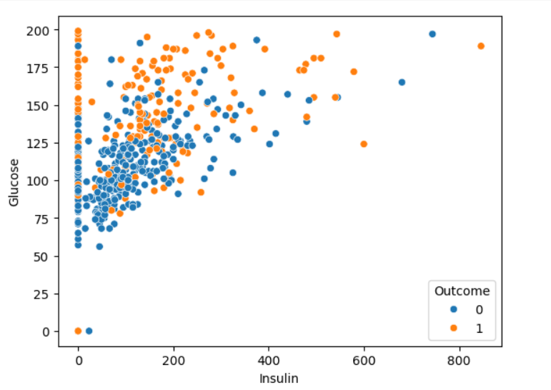
Scatter Plot
scattar plot comparing accuracy of all models

Slide 8
Conclusion- Summary of Findings: Key insights from data distribution analysis - Best-performing model based on evaluation metrics
Future Work: Potential improvements (e.g., more data, advanced models, feature selection)

